Slide 1




Breaking the ice with Pester for PowerShell tinkerers
@codaamok

Slide 2



About me 🙃
Adam Cook (Southampton, UK)
Support Engineer at Patch My PC
PowerShell, ConfigMgr, and Azure (and WSUS )
Blog
SysManSquad – https://sysmansquad.com
Adam Cook https://adamcook.io
PowerShell Southampton user group
https://pssouth.co.uk
Scan to get deck content
acook.io/presentations

Slide 3
About the session
~1 hour
Get all content from https://acook.io/presentations
Breaking the ice with Pester
Why you should use it
How it fits into a pipeline
Demos showing you the essentials and some real examples
You need:
Some experience with PowerShell
Some git knowledge is ideal but not essential
Zero knowledge of “unit” or “acceptance” testing or Pester
Scan to get deck content
acook.io/presentations

Slide 4
History of Pester
Born by Scott Muc (@scottmuc) in 2011
Primarily maintained today by Jakub Jareš (@nohwnd)
Came shipped with Windows in 2015
Scan to get deck content
acook.io/presentations
Notes:
Came with Windows in 2015
- First open-source project to be shipped with Windows
- This caused problems when maintainers changed and the signature used to sign the module changed

Slide 5
Notes:
Pester is a fantastic tool that will leap you and your code forward
It will help you focus on the important things: fixing code and making new features/improvements

Slide 6
Why? 🤔
Survival
Sharing and fostering contribution
JFDI
No more recurring bugs
Test infrastructure and/or services!
Scan to get deck content
acook.io/presentations
Notes:
Ideal for code if you:
want to survive a long time
share with others and encourage contribution
manage multiple projects and do not need to remember every inner working detail all the time
JFDI your work and let the tests prove you wrong
do not want bugs do not reappear!
test infrastructure or services!
Why do I learn it?
Felt like ‘hotness’
However, the more I learned about the value of testing code, the more I wanted it
Talk about PSShlink: its API changes frequently

Slide 7
All you need to know ^{(right now} 😉 ⁾
Three functions:
Describe [-Name] <String> [-Fixture] <ScriptBlock>
It [-Name] <String> [-Test] <ScriptBlock>
Should [-ActualValue] <Object>
Describe "Get-WinAdminsMembers" {
It "Should not be null or empty" {
Get-WinAdminsMembers | Should -Not -BeNullOrEmpty
}
}
Describe "Get-WinAdminsMembers" {
It "Should not be null or empty" {
Get-WinAdminsMembers | Should -Not -BeNullOrEmpty
}
}
Notes:
There are more than just 3, and there’s more
A framework with its own DSL that resembles syntax like another testing framework from Ruby
Describe:
Describe the ‘subject’ of the test, i.e. the target. e.g. a function, script, or server name
Every test file needs at least one
Contains It blocks
It:
Describe the test case itself, ie describe the act you are about to perform
Can have infinite number of test cases within a Describe block
Contains executable code and one or more assertions should ‘Should’
Should:
Is an assertion
Takes data from pipeline
Use many of the available operators available

Slide 8
CI/CD Pipeline 🚀
Continuous Integration and Continuous Deployment or Continuous Delivery
Pipeline
CI
CD
Make change to code, check it in to source control
Build
Test
Deploy to production
Approval
Scan to get deck content
acook.io/presentations
Notes:
“Demystifying”, “break it down”, “practical terms”
Explaining this is relevant because leveraging GitHub Actions means == you will be practicing at the very least the deployment/delivery part of CI/CD
Not a new idea, but it is for me / sysadmins
What is it?
Continuous Integration: asking “Does the code I have checked in, conform or pass a series of tests?”
Continuous Delivery/Deployment: essentially getting your code from A to B
Will explain diff between deployment v delivery soon (this slide)
A practice of automating the testing and deployment of code
Creates a pipeline:
<click>
Check in code
<click>
Build:
To produce an artifact
For me was difficult to understand, I’ve already built my code, why am I being told I should build it again… after checking in my already built code?
Give non-PS and PS example (talk about building modules)
<click>
Test:
“Does this artifact conform or pass a series of tests?”
Give high-level examples of testing code, input & expected output
Mention Pester
In the demos later, I will be not demoing code testing, focusing purely on the deployment
<click>
Deploy:
Finally, get your code to production
PowerShell Gallery / file share / internal NuGet repository / directly to servers
<click>
Pipeline – this is what is preferred to as the “pipeline”
<click>
CI + CD – break down the pipeline
<click>
Approval – difference between Delivery v Deployment
<click>
Why do it?
Avoid being put off to ship changes/fixes
Frees us from the logistical or admin
Improved focus on the code or project itself
Don’t worry about remembering
how to get it where it needs to go
what the next version number should be
To include release notes

Slide 9
Real world examples
Rob Sewell (@sqldbawithbeard) blogs on querying SQL servers with sa account enabled, and writing Pester tests which reports on a SQL server conforming to this test
https://sqldbawithabeard.com/2017/11/16/write-your-first-pester-test-today/
Recently implemented acceptance tests as part of my CI/CD pipeline for a module I maintain
https://github.com/codaamok/PSShlink/tree/main/tests
Scan to get deck content
acook.io/presentations

Slide 10
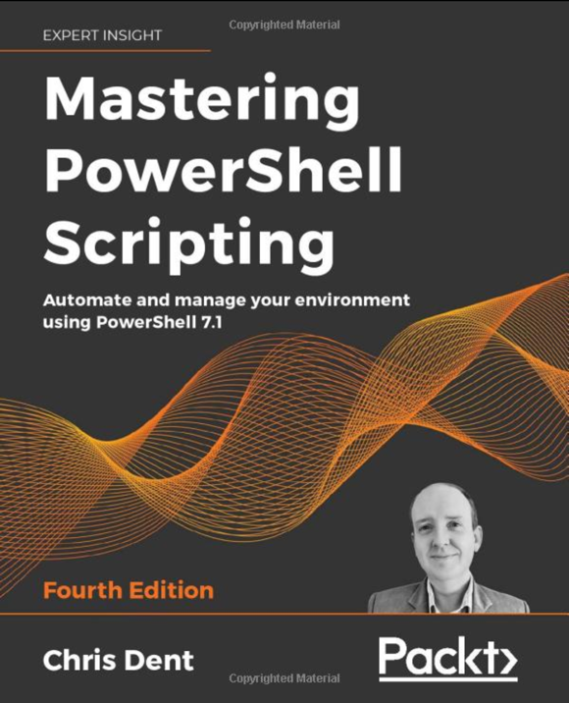
Final comments
Docs
https://pester-docs.netlify.app
YouTube playlist:
https://acook.io/pesterplaylist
Mastering PowerShell Scripting - Chris Dent
https://www.amazon.co.uk/Mastering-PowerShell-Scripting-Automate-environment/dp/1800206542
Scan to get deck content
acook.io/presentations

